Slide 1
MODERN OPERATING SYSTEMS
Chapter 1
Introduction
Tanenbaum, Modern Operating Systems 3 e, (c) 2008 Prentice-Hall, Inc. All rights reserved. 0-13-6006639

Slide 2
What Is An Operating System?
Lots of hardware !!
One or more processors
Main memory
Disks
Printers
Various input/output devices
Managing all these components requires a layer of software – the operating system
Tanenbaum, Modern Operating Systems 3 e, (c) 2008 Prentice-Hall, Inc. All rights reserved. 0-13-6006639

Slide 3
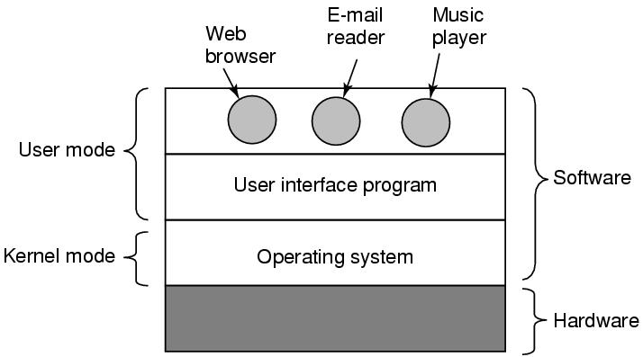
Where is the software?
Where the operating system fits in.
Tanenbaum, Modern Operating Systems 3 e, (c) 2008 Prentice-Hall, Inc. All rights reserved. 0-13-6006639

Slide 4
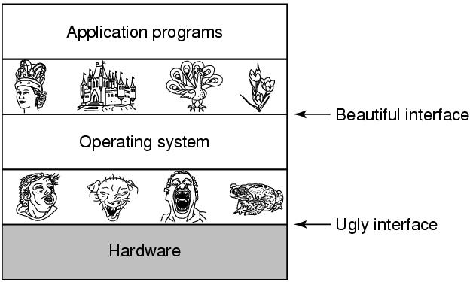
The Operating System as an Extended Machine
Tanenbaum, Modern Operating Systems 3 e, (c) 2008 Prentice-Hall, Inc. All rights reserved. 0-13-6006639

Slide 5
The Operating System as a Resource Manager
Allow multiple programs to run at the same time
Manage and protect memory, I/O devices, and other resources
Multiplexes (shares) resources in two different ways:
  In time
  In space
Tanenbaum, Modern Operating Systems 3 e, (c) 2008 Prentice-Hall, Inc. All rights reserved. 0-13-6006639

Slide 6
History of Operating Systems
Generations:
(1945–55) Vacuum Tubes
(1955–65) Transistors and Batch Systems
(1965–1980) ICs and Multiprogramming
(1980–Present) Personal Computers, Tablets, Phones
Tanenbaum, Modern Operating Systems 3 e, (c) 2008 Prentice-Hall, Inc. All rights reserved. 0-13-6006639

Slide 7

Transistors and Batch Systems (1)
Figure 1-3. An early batch system.
(a) Programmers bring cards to 1401.
(b)1401 reads batch of jobs onto tape.
Tanenbaum, Modern Operating Systems 3 e, (c) 2008 Prentice-Hall, Inc. All rights reserved. 0-13-6006639

Slide 8
Transistors and Batch Systems (2)
Figure 1-3. (c) Operator carries input tape to 7094.
(d) 7094 does computing. (e) Operator carries output tape to 1401. (f) 1401 prints output.
Tanenbaum, Modern Operating Systems 3 e, (c) 2008 Prentice-Hall, Inc. All rights reserved. 0-13-6006639

Slide 9
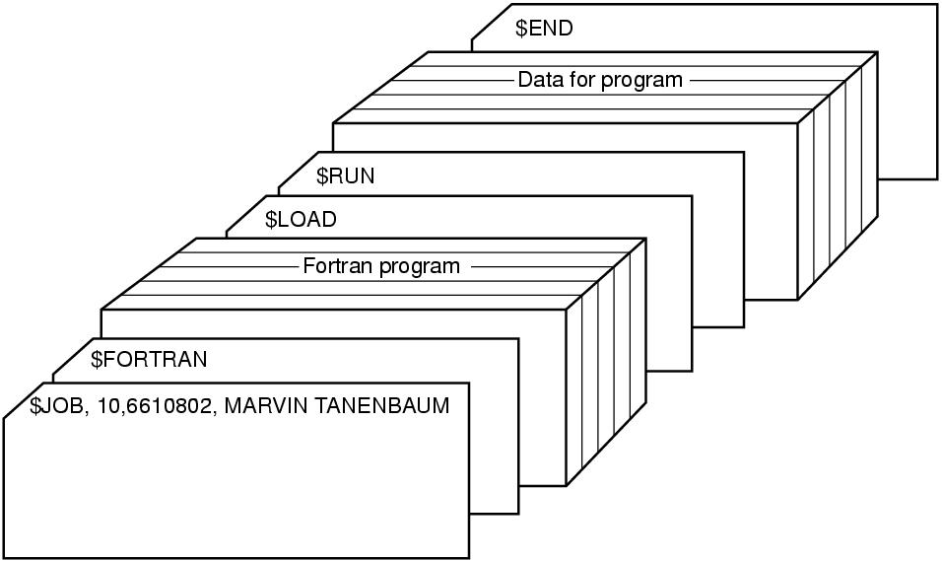
Transistors and Batch Systems (4)
Figure 1-4. Structure of a typical FMS job.
Tanenbaum, Modern Operating Systems 3 e, (c) 2008 Prentice-Hall, Inc. All rights reserved. 0-13-6006639

Slide 10

ICs and Multiprogramming
Figure 1-5. A multiprogramming system
with three jobs in memory.
Tanenbaum, Modern Operating Systems 3 e, (c) 2008 Prentice-Hall, Inc. All rights reserved. 0-13-6006639
Notes:
MULTICS
Timesharing CTSS (MIT)
Multics
UNix

Slide 11
More third generation
Time Sharing (CTSS)
Multics
Unix
Linux
.
Tanenbaum, Modern Operating Systems 3 e, (c) 2008 Prentice-Hall, Inc. All rights reserved. 0-13-6006639
Notes:
MULTICS
Timesharing CTSS (MIT)
Multics
UNix

Slide 12
Fourth generation
PCs
Network Operating Systems
Distributed Operating Systems
.
Tanenbaum, Modern Operating Systems 3 e, (c) 2008 Prentice-Hall, Inc. All rights reserved. 0-13-6006639
Notes:
MULTICS
Timesharing CTSS (MIT)
Multics
UNix

Slide 13
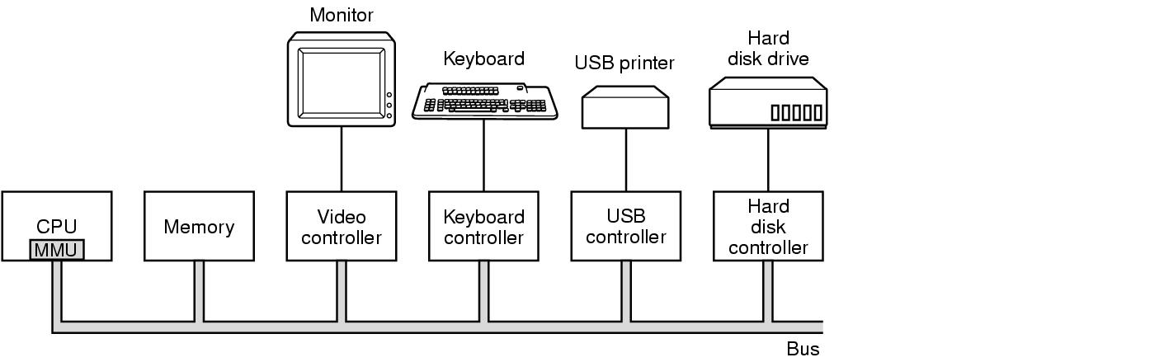
Computer Hardware Review
Some of the components
of a simple personal computer.
Tanenbaum, Modern Operating Systems 3 e, (c) 2008 Prentice-Hall, Inc. All rights reserved. 0-13-6006639

Slide 14
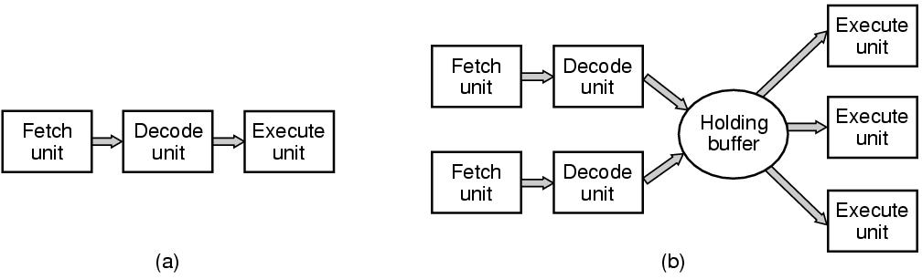
CPU Pipelining
Figure 1-7. (a) A three-stage pipeline. (b) A superscalar CPU.
Tanenbaum, Modern Operating Systems 3 e, (c) 2008 Prentice-Hall, Inc. All rights reserved. 0-13-6006639

Slide 15
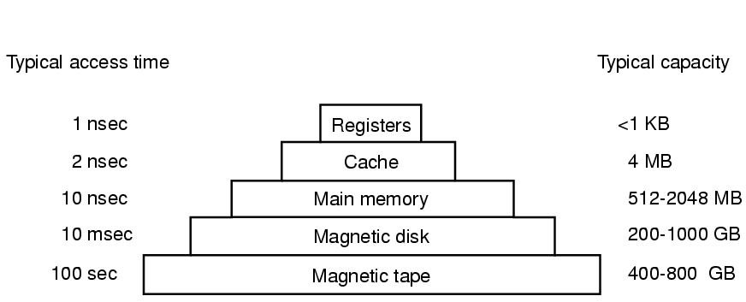
Memory Hierarchy
A typical memory hierarchy.
The numbers are very rough approximations.
Tanenbaum, Modern Operating Systems 3 e, (c) 2008 Prentice-Hall, Inc. All rights reserved. 0-13-6006639

Slide 16
Caches
Main memory is divided into cache lines (64 bytes)
  0-63 in line 1, 64-127 in line 2
When program reads a word-cache hardware checks to see if in cache.
  If so, then have a cache hit (2 cycles).
  Otherwise, make request of main memory over the bus (expensive)
Cache is expensive and is therefore limited in size
Can have cache hierarchies
Cache other things, like URL addresses
Tanenbaum, Modern Operating Systems 3 e, (c) 2008 Prentice-Hall, Inc. All rights reserved. 0-13-6006639

Slide 17
The 4 Cache Questions
When to put a new item into the cache? (on a cache miss)
Which cache line to put the new item in? (memory word determines which line)
Which item to remove from the cache when a slot is needed? (same line new data goes into)
Where to put a newly evicted item in main memory? (memory address determines this)
Tanenbaum, Modern Operating Systems 3 e, (c) 2008 Prentice-Hall, Inc. All rights reserved. 0-13-6006639

Slide 18
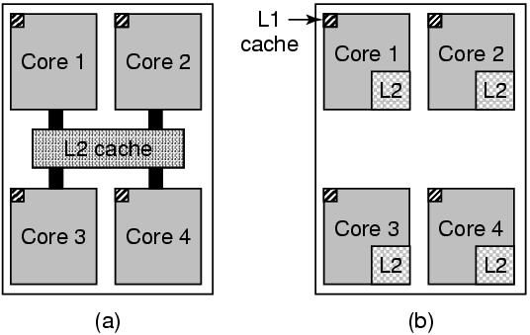
Multithreaded and Multicore Chips
(a) A quad-core chip with a shared L2 cache.
(b) A quad-core chip with separate L2 caches.
Tanenbaum, Modern Operating Systems 3 e, (c) 2008 Prentice-Hall, Inc. All rights reserved. 0-13-6006639

Slide 19
Main Memory
RAM
ROM-can’t be changed. Fast, cheap
  eg.-keeps bootstrap OS loader
EEPROM (Electrically Erasable PROM) Can be re-written, but slowly
  E.g.-serves as films in digital cameras, as disk in portable music players
.
Tanenbaum, Modern Operating Systems 3 e, (c) 2008 Prentice-Hall, Inc. All rights reserved. 0-13-6006639
Notes:
MULTICS
Timesharing CTSS (MIT)
Multics
UNix

Slide 20
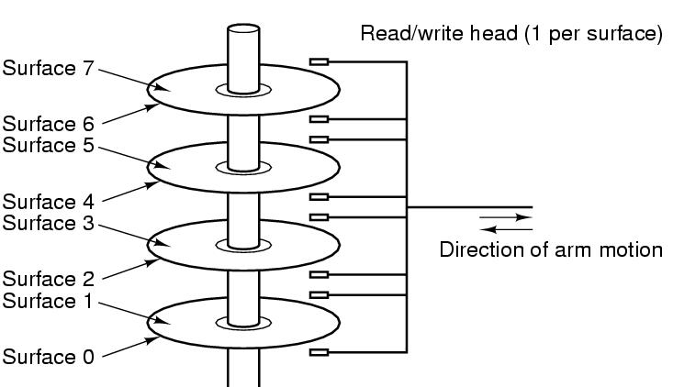
Disks
Tracks are divided into sectors (512 bytes)
Multiple tracks form a cylinder.
Tanenbaum, Modern Operating Systems 3 e, (c) 2008 Prentice-Hall, Inc. All rights reserved. 0-13-6006639

Slide 21
I/O Devices
Controller runs a device-accepts commands from the OS and executes them
Complicated business
  Eg. Gets command to read sector x on disk y. Must convert to (cylinder, sector, head) address, move arm to correct cylinder, wait for sector to rotate under the head, read and store bits coming off the drive, compute checksum, store bits as words in memory
  Controller contains a computer to run its device
Tanenbaum, Modern Operating Systems 3 e, (c) 2008 Prentice-Hall, Inc. All rights reserved. 0-13-6006639

Slide 22
Device Driver
OS software that talks to controller-gives commands, accepts responses
Each controller manufacturer supplies a driver for each OS
Driver runs in kernel mode
Controller has registers which are used to communicate with the driver
Three modes of communication
    Polling
    Interrupts
    DMA
Tanenb aum, Modern Operating Systems 3 e, (c) 2008 Prentice-Hall, Inc. All rights reserved. 0-13-6006639

Slide 23
I/O by polling device
Driver issues command to controller
Driver polls device until it is ready
Eg Send character to printer controller and poll until it is ready to accept the next character
Big use of CPU
Called programmed I/O-not really used any more
Tanenbaum, Modern Operating Systems 3 e, (c) 2008 Prentice-Hall, Inc. All rights reserved. 0-13-6006639

Slide 24
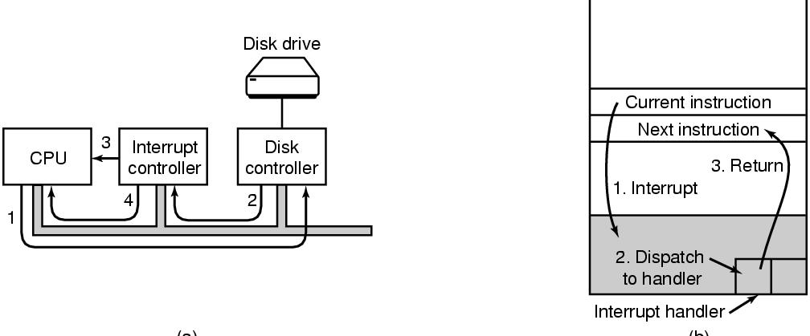
I/O by Interrupts
Generate an interrupt when I/O is finished.
Eg When character is finished being printed, interrupt CPU. Allows CPU to do something else while character is being printed
Tanenbaum, Modern Operating Systems 3 e, (c) 2008 Prentice-Hall, Inc. All rights reserved. 0-13-6006639

Slide 25
I/O by DMA
Special (controller) chip
Avoids using the CPU as part of the transfer to/from memory
CPU tells chip to set up transfer and take care of it
Chip does as it it told and interrupts CPU when it is finished
Tanenbaum, Modern Operating Systems 3 e, (c) 2008 Prentice-Hall, Inc. All rights reserved. 0-13-6006639

Slide 26
The bus hierarchy
In the beginning there was one bus-couldn’t handle the traffic when cpu and memories got faster and bigger
Create a hierarchy of faster buses (PCI) and specialized buses (SCSI, USB)
Tanenbaum, Modern Operating Systems 3 e, (c) 2008 Prentice-Hall, Inc. All rights reserved. 0-13-6006639

Slide 27
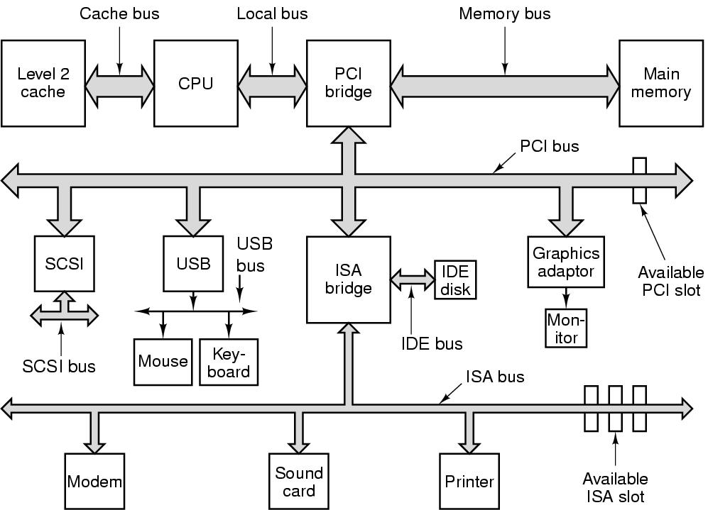
Pentium System Buses
The structure of a large Pentium system
Tanenbaum, Modern Operating Systems 3 e, (c) 2008 Prentice-Hall, Inc. All rights reserved. 0-13-6006639

Slide 28
The Operating System Zoo
Mainframe operating systems
  Big-thousands of disks….
  Lots of jobs with lots of I/O
  Services-batch (payroll) transactions (airline reservations, timesharing (query database)
  Elderly-Unix, Linux replacing them
Tanenbaum, Modern Operating Systems 3 e, (c) 2008 Prentice-Hall, Inc. All rights reserved. 0-13-6006639

Slide 29
The Operating System Zoo
Server operating systems
  Workstations
  File, print, web servers
  BSD, Linux, Windows
  Multiprocessor operating systems
    Use multiple cores
Tanenbaum, Modern Operating Systems 3 e, (c) 2008 Prentice-Hall, Inc. All rights reserved. 0-13-6006639

Slide 30
The Operating System Zoo
PC operating systems-Linux, Mac, Windows
Smart phone operating systems- Android, iPhone, Blackberry
  No hard disk
  Palm, Symbian popular OS’s
Tanenbaum, Modern Operating Systems 3 e, (c) 2008 Prentice-Hall, Inc. All rights reserved. 0-13-6006639

Slide 31
The Operating System Zoo
Embedded operating systems-TV sets, cars, DVDs, MP3s
  Everything is in ROM (no apps can run on it)
  QNx, Vxworks
Real time operating systems
  Hard (eg. factory) deadline
  Soft (eg. multi-media) deadline
  Smart card OS (eg border crossing cards)
    Java in ROM
Tanenbaum, Modern Operating Systems 3 e, (c) 2008 Prentice-Hall, Inc. All rights reserved. 0-13-6006639

Slide 32
Operating System Concepts
Processes
Address spaces
Files
Input/Output
Protection
The shell
Tanenbaum, Modern Operating Systems 3 e, (c) 2008 Prentice-Hall, Inc. All rights reserved. 0-13-6006639

Slide 33
Processes
Program in execution
Lives in address space
Process table
  Keeps info about process
  Used to re-start process
Shell (command interpreter) reads commands from terminal
Tanenbaum, Modern Operating Systems 3 e, (c) 2008 Prentice-Hall, Inc. All rights reserved. 0-13-6006639

Slide 34

A Process Tree
Process creates child processes
Tree structure
Tanenbaum, Modern Operating Systems 3 e, (c) 2008 Prentice-Hall, Inc. All rights reserved. 0-13-6006639

Slide 35
Process
Can communicate with one another
Have UID’s and group ID’s (GID)
Can communicate with one another (IPC)
Tanenbaum, Modern Operating Systems 3 e, (c) 2008 Prentice-Hall, Inc. All rights reserved. 0-13-6006639

Slide 36
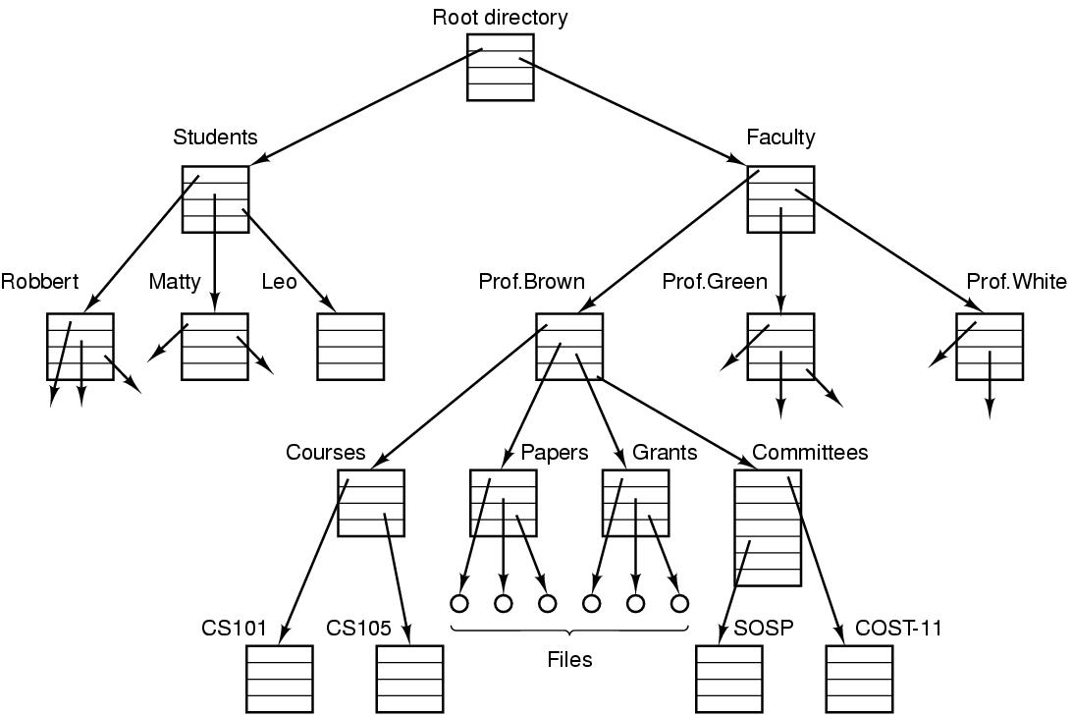
File directory
  The directory is organized as a tree
  Root directory at the top. Path proceeds from the root (e.g. faculty/prof brown/courses)
Tanenbaum, Modern Operating Systems 3 e, (c) 2008 Prentice-Hall, Inc. All rights reserved. 0-13-6006639

Slide 37
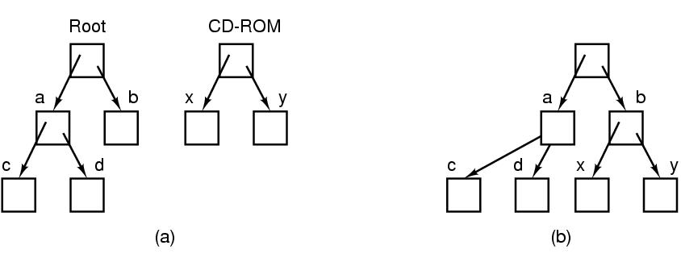
Mounting Files in UNIX
A CD-ROM is mounted on directory b.
Tanenbaum, Modern Operating Systems 3 e, (c) 2008 Prentice-Hall, Inc. All rights reserved. 0-13-6006639

Slide 38
Special files
Special files-can use same calls for I/O as for files. OS treats them as files.
  Block special files (disks)
  Character special files (line printers, modems)
  Kept in /dev directory, e.g. /dev/lp is line printer
Tanenbaum, Modern Operating Systems 3 e, (c) 2008 Prentice-Hall, Inc. All rights reserved. 0-13-6006639

Slide 39
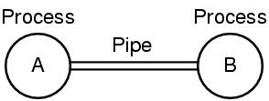
Unix Pipe
Processes communicate by writing into/reading from a file in Unix
A and B write into the pipe and read from the pipe.
Tanenbaum, Modern Operating Systems 3 e, (c) 2008 Prentice-Hall, Inc. All rights reserved. 0-13-6006639

Slide 40
I/O, Protection/Shell
I/O-big part of OS
Protection-UNIX uses rwx bits for each file
  3 bits for owner, 3 for group, 3 for everyone else
Shell (command interpreter)
  UNIX
  Has lots of flavors-sh,bash,csh,ssh…..
  Sort<file1>file2
  Cat file 1 file 2 file3 | sort > /dev/lp
Tanenbaum, Modern Operating Systems 3 e, (c) 2008 Prentice-Hall, Inc. All rights reserved. 0-13-6006639

Slide 41
System Calls
Interface between user programs and OS
Varies from OS to OS
System call issued by user program
Call uses a library call of the same name
Library routine puts machine into kernel modes (by issuing a special instruction)
Finds actual routine for system call in a table
Does the work involved in the call
Returns to user program
Tanenbaum, Modern Operating Systems 3 e, (c) 2008 Prentice-Hall, Inc. All rights reserved. 0-13-6006639

Slide 42
Unix Read System Call
Count=read(fd, buffer, nbytes)
  fd is a file descriptor. When a file is opened, permissions are checked. If access is allowed, a number (fd) is returned. Then file can be read/written
  nbytes is number of bytes in file
  buffer is where read deposits the bytes
Tanenbaum, Modern Operating Systems 3 e, (c) 2008 Prentice-Hall, Inc. All rights reserved. 0-13-6006639

Slide 43

System Calls
read(fd, buffer, nbytes).
Tanenbaum, Modern Operating Systems 3 e, (c) 2008 Prentice-Hall, Inc. All rights reserved. 0-13-6006639

Slide 44
Look at System Calls
Start with process management
  See how they are used in shell
  Then you write a shell
Then do a brief summary of calls for
  File management
  Other useful calls
Tanenbaum, Modern Operating Systems 3 e, (c) 2008 Prentice-Hall, Inc. All rights reserved. 0-13-6006639

Slide 45
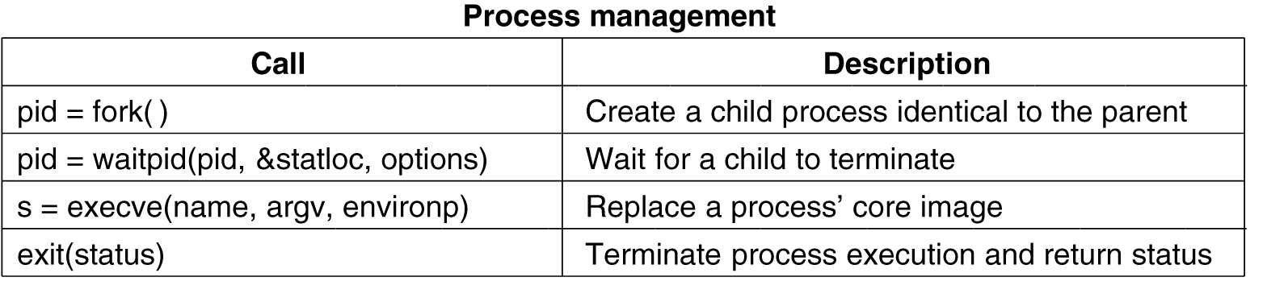
System Calls for Process Management
Tanenbaum, Modern Operating Systems 3 e, (c) 2008 Prentice-Hall, Inc. All rights reserved. 0-13-6006639

Slide 46
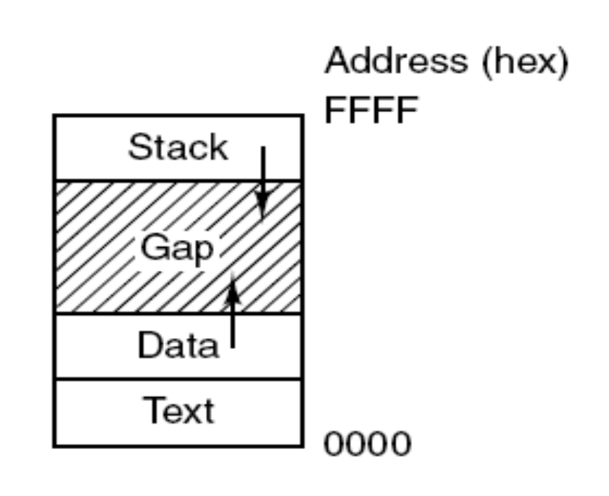
Memory Layout
Processes have three segments:
text, data, and stack.
Tanenbaum, Modern Operating Systems 3 e, (c) 2008 Prentice-Hall, Inc. All rights reserved. 0-13-6006639

Slide 47
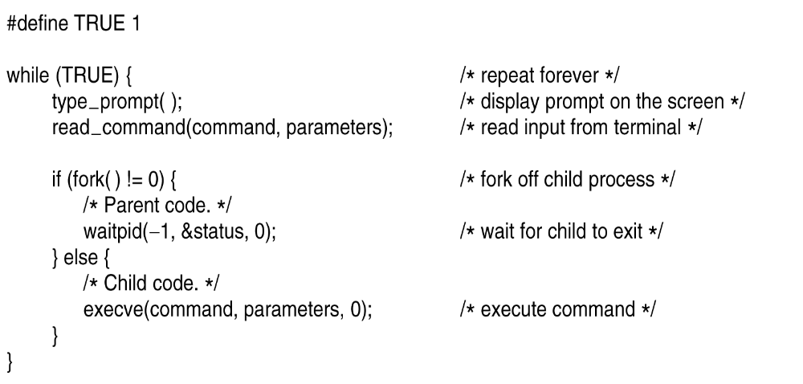
Shell
.
Tanenbaum, Modern Operating Systems 3 e, (c) 2008 Prentice-Hall, Inc. All rights reserved. 0-13-6006639

Slide 48
Fork
Pid=fork( )
  Duplicates parent process completely Everything duplicated -data,registers,fd’s
  Fork returns a value (pid)
    Zero in child
    Child’s PID in parent
    Used to differentiate child from parent
Tanenbaum, Modern Operating Systems 3 e, (c) 2008 Prentice-Hall, Inc. All rights reserved. 0-13-6006639

Slide 49
Execve
Replaces process’ core image by the file named in its invocation
Execve(name,arg,environp) has 3 parameters
  Name of file (e.g. cp command)
  Arg-pointer to argument array
  Environp-pointer to environment array
Tanenbaum, Modern Operating Systems 3 e, (c) 2008 Prentice-Hall, Inc. All rights reserved. 0-13-6006639

Slide 50
Excve (example)
Cp f1 f2 is located by execve and parameters are passed to it by execve
  Main(argc, argv, envp) is main prog in cp
    Argc is #items on command line (=3 in cp)
    Argv points to array (arg[0] points to cp, arg[1] points to f1,
    Envp points to environment, an array of name=value with info like terminal type
Tanenbaum, Modern Operating Systems 3 e, (c) 2008 Prentice-Hall, Inc. All rights reserved. 0-13-6006639

Slide 51
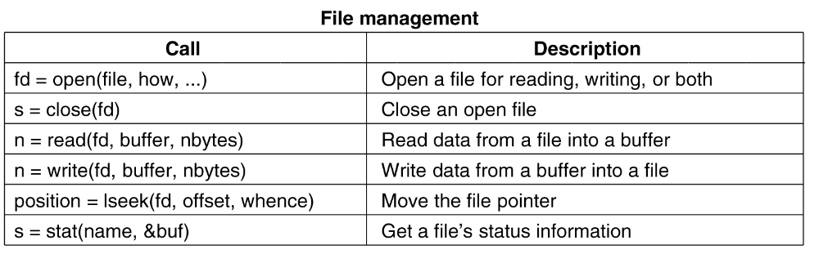
System Calls for File Management
.
Tanenbaum, Modern Operating Systems 3 e, (c) 2008 Prentice-Hall, Inc. All rights reserved. 0-13-6006639

Slide 52
File mode
System keeps track of it
  Regular, special
  Date of creation
  Size
  Access status of file via stat command
Tanenbaum, Modern Operating Systems 3 e, (c) 2008 Prentice-Hall, Inc. All rights reserved. 0-13-6006639

Slide 53
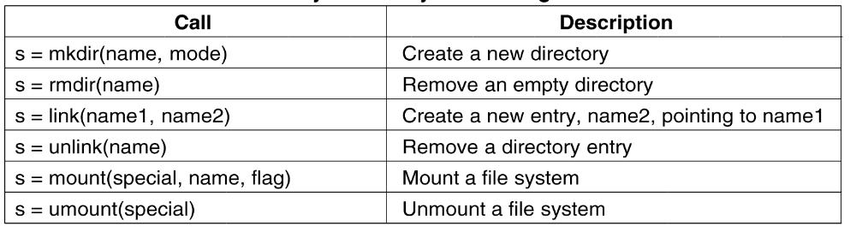
System Calls for Directory and File Management
.
Tanenbaum, Modern Operating Systems 3 e, (c) 2008 Prentice-Hall, Inc. All rights reserved. 0-13-6006639

Slide 54
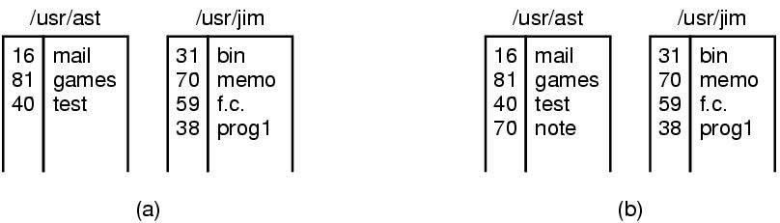
Linking
In Unix, each file is identified by an i-number
i-number indexes into i-node table
  Link creates a new directory entry with same i-number
  Has a new name (note instead of memo)
Tanenbaum, Modern Operating Systems 3 e, (c) 2008 Prentice-Hall, Inc. All rights reserved. 0-13-6006639

Slide 55
Mount System Call
mount(“/dev/fd0”, “/mnt”, 0) is system call
File comes from drive 0 and is mounted on binary file /mnt.
Third parameter tells if it is read or read-write
Result is that file on drive zero can be accessed from a directory
Saw this example before with CD-same mechanism for memory sticks and portions of hard drives
Tanenbaum, Modern Operating Systems 3 e, (c) 2008 Prentice-Hall, Inc. All rights reserved. 0-13-6006639

Slide 56
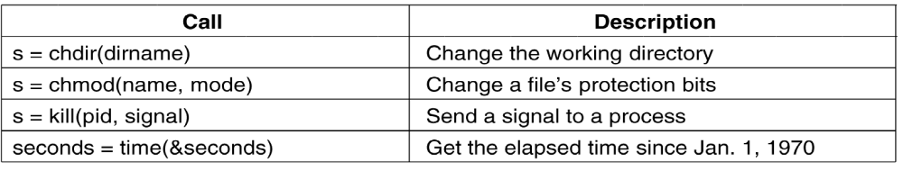
Other System Calls
Tanenbaum, Modern Operating Systems 3 e, (c) 2008 Prentice-Hall, Inc. All rights reserved. 0-13-6006639

Slide 57
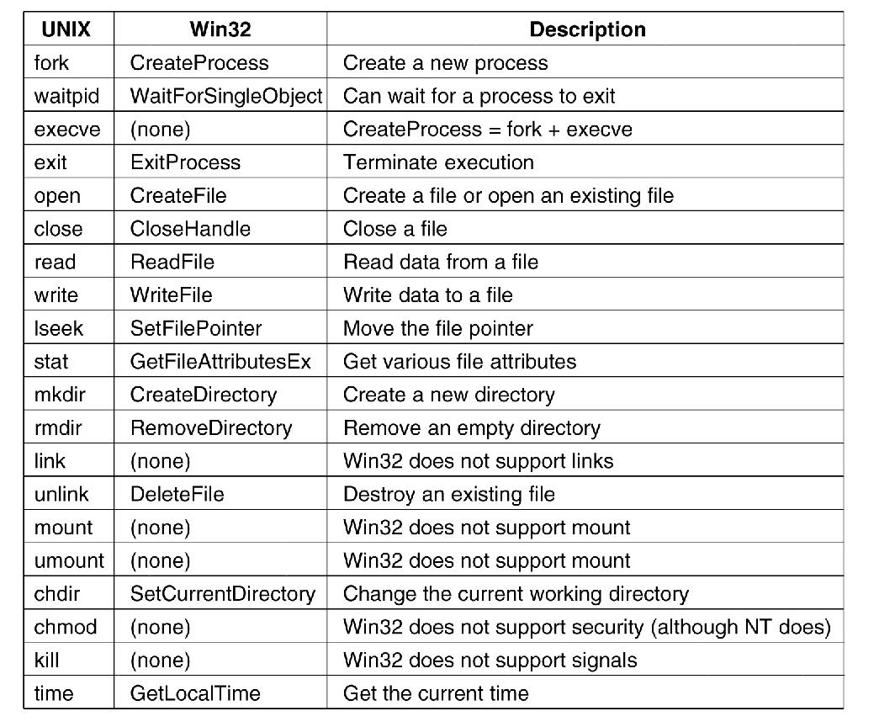
Windows Win32 API
The Win32 API calls that roughly correspond
to the UNIX calls
Tanenbaum, Modern Operating Systems 3 e, (c) 2008 Prentice-Hall, Inc. All rights reserved. 0-13-6006639

Slide 58
Operating Systems Structure
Monolithic systems
A main program that invokes the requested service procedure.
A set of service procedures that carry out the system calls.
A set of utility procedures that help the service procedures.
Tanenbaum, Modern Operating Systems 3 e, (c) 2008 Prentice-Hall, Inc. All rights reserved. 0-13-6006639

Slide 59
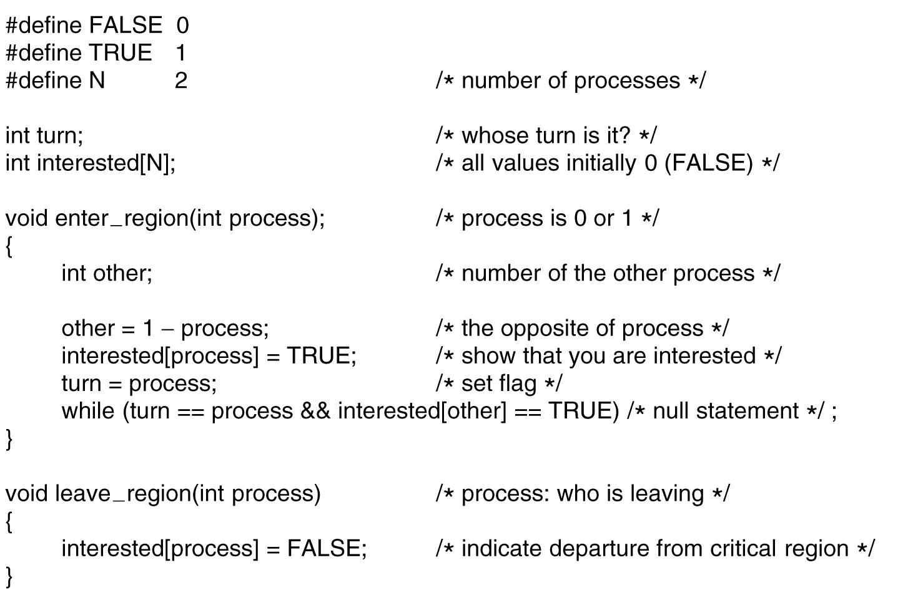
Monolithic Systems
A simple structuring model for a monolithic system.
Tanenbaum, Modern Operating Systems 3 e, (c) 2008 Prentice-Hall, Inc. All rights reserved. 0-13-6006639

Slide 60
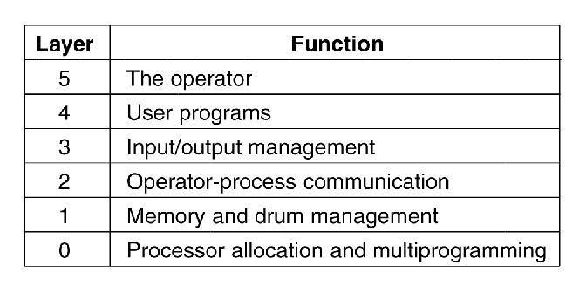
Layered Systems-THE operating system
Dijkstra’s the author
Tanenbaum, Modern Operating Systems 3 e, (c) 2008 Prentice-Hall, Inc. All rights reserved. 0-13-6006639

Slide 61
Microkernels
Small number of processes are allowed in the kernel
Minimizes effects of bugs
  Don’t want bug in driver to crash system
Put mechanism in kernel and policy outside the kernel
  Mechanism- schedule processes by priority scheduling algorithm
  Policy-assign process priorities in user space
Tanenbaum, Modern Operating Systems 3 e, (c) 2008 Prentice-Hall, Inc. All rights reserved. 0-13-6006639

Slide 62
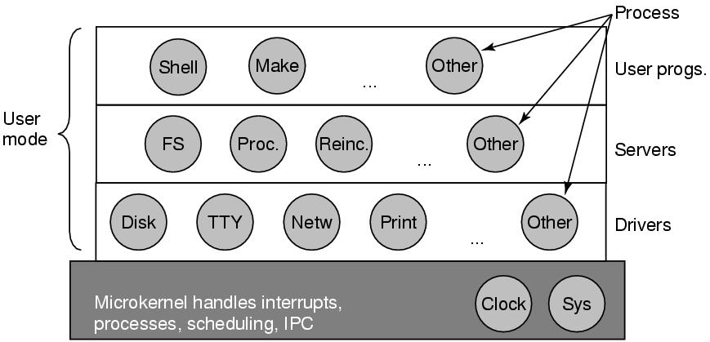
Microkernels
Structure of the MINIX 3 system.
Tanenbaum, Modern Operating Systems 3 e, (c) 2008 Prentice-Hall, Inc. All rights reserved. 0-13-6006639

Slide 63
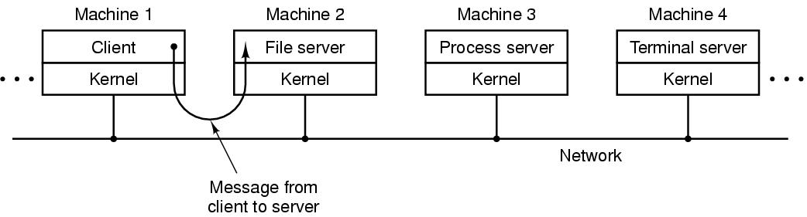
Client-Server Model
The client-server model over a network.
Tanenbaum, Modern Operating Systems 3 e, (c) 2008 Prentice-Hall, Inc. All rights reserved. 0-13-6006639

Slide 64
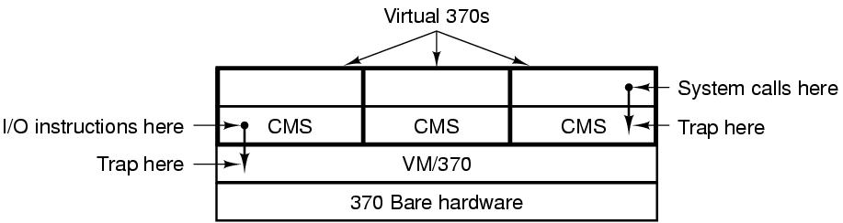
Virtual Machines (1)
The structure of VM/370 with CMS.
Tanenbaum, Modern Operating Systems 3 e, (c) 2008 Prentice-Hall, Inc. All rights reserved. 0-13-6006639

Slide 65
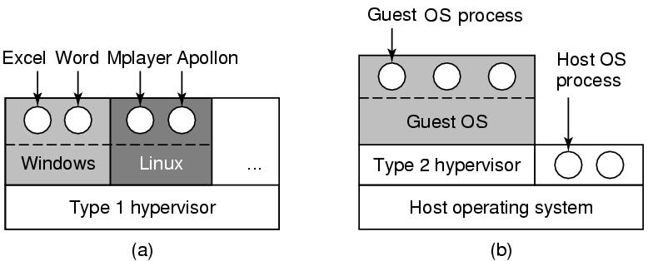
Virtual Machines (2)
(a) A type 1 hypervisor. (b) A type 2 hypervisor.
Tanenbaum, Modern Operating Systems 3 e, (c) 2008 Prentice-Hall, Inc. All rights reserved. 0-13-6006639

Slide 66
The World According to C
The C language
Header files
Large programming projects
The model of run time
Tanenbaum, Modern Operating Systems 3 e, (c) 2008 Prentice-Hall, Inc. All rights reserved. 0-13-6006639

Slide 67
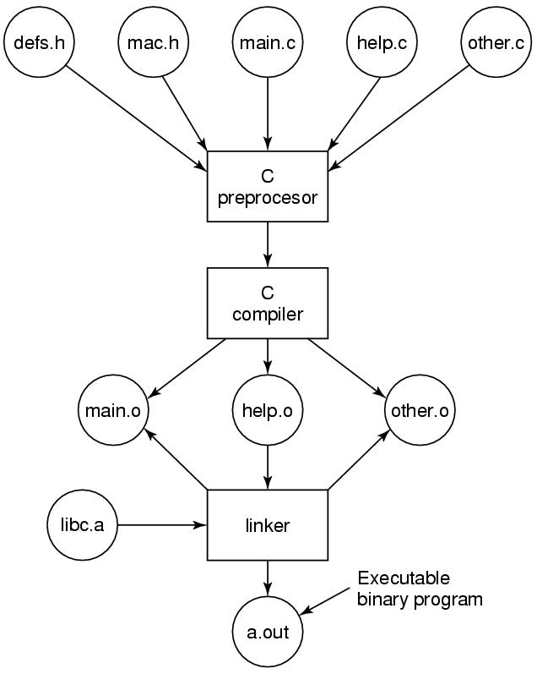
The Model of Run Time
The process of compiling C and header files to make an executable.

